Slide 1

Unit 16 – Procedural Programming
with Ben Read

Slide 2
AIMS & OBJECTIVES
Review the use of complex decision statements
Understand the concept of nesting in both conditional and choice-based statements
Partake in a self-paced tutorial to revise programming concepts

Slide 3
CONDITIONAL OPERATOR (?)
The Conditional Operator, ‘?’, is a compact form of an if() statement.
It is used to check an expression and then carry out one of two tasks depending upon the result.
It resembles (expression) ? result1 : result2 and is used like this -
int integer1 = 25, integer2 = 50, largest_integer;
largest_integer = (integer1 > integer2) ? integer1 : integer2;

Slide 4
IF…ELSE
Simple If statements check if a condition is true and if so then one or more tasks are carried out
If statements can be further enhanced with the use of else to allow other tasks to execute even if the initial condition was false

Slide 5
IF…ELSE
Syntax of if...else statement
if(boolean_expression)
{
// Body of if
// If expression is true then execute this
}
else
{
// Body of else
// If expression is false then execute this
}
In the syntax above, if the boolean expression is found to be true then the if statement block executes. Otherwise the else statement is executed. In any case, one of the statements must always execute. In no case will both blocks execute.

Slide 6
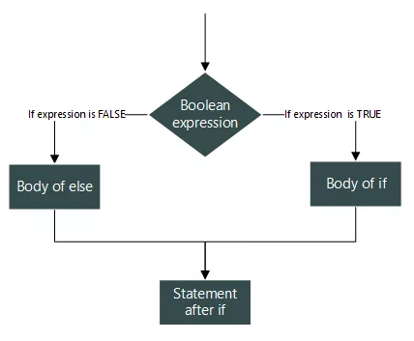
IF…ELSE
Flowchart of if…else statement

Slide 7
IF…ELSE…IF
Often, one If…else statement is not enough. Sometimes multiple options need to be considered. Consider the following real life scenario –
If I have at least £1200, then I will purchase a Microsoft Surface Book.
Otherwise, if I have at least £1000 then I will purchase an Apple Macbook Air.
Otherwise, if I have at least £800 then I will purchase HP Ultra-book.
Otherwise, I will purchase the best laptop I can afford.
Each condition is dependent on the parent condition and must be checked sequentially. Once a condition is found to be true then all the others can be ignored.

Slide 8
IF…ELSE…IF
if (boolean_expression_1)
{
// If expression 1 is true then execute
// this and skip other if
}
else if (boolean_expression_2)
{
// If expression 1 is false and
// expression 2 is true then execute
// this and skip other if
}
else if (boolean_expression_n)
{
// If expression 1 is false,
// expression 2 is also false,
// expression n-1 is also false,
// and expression n is true then execute
// this and skip else.
}
else
{
// If no expressions are true then
// execute this skipping all other.
}
Syntax of if...else…if statement ladder

Slide 9
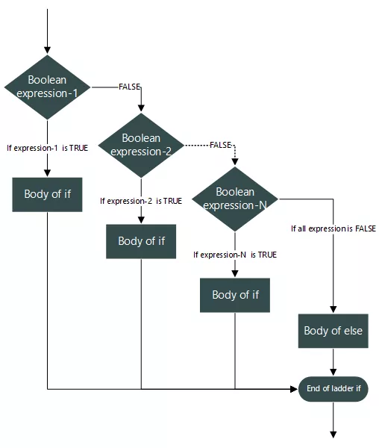
IF…ELSE…IF

Slide 10
ELSE IF
When moving from an if statement to an else statement, sometimes it is a requirement to continue testing conditions. This can be done with either -
Else Else If()
{ {
If() OR }
{
}
}

Slide 11
NESTED IF & ELSE IF
Sometimes you will need to create far more complex conditional statements in order to solve a problem. To achieve this we can use something called nesting. Nesting is where if and else statements are stacked in sequence, creating multiple levels of condition.
Each condition within a nested if must be met in order to continue deeper into the sequence. As soon as one condition is not met the current if statement breaks and the program moves on to the next if, else if, or else section of the statement, or ends.

Slide 12
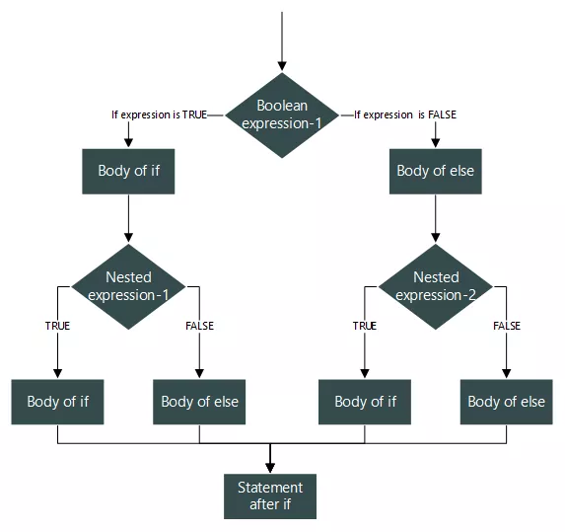
NESTED IF & ELSE IF

Slide 13
SWITCH…CASE
switch...case is a branching statement used to perform actions based on available choices, instead of making decisions based on conditions. Using switch...case you can write cleaner and more optimal code than with an if...else statement.
switch...case only works with integer, character and enumeration constants.

Slide 14
SWITCH…CASE
Syntax of switch...case statement
switch(expression)
{
case 1:
/* Statement/s */
break;
case 2:
/* Statement/s */
break;
case n:
/* Statement/s */
break;
default:
/* Statement/s */
}

Slide 15
SWITCH…CASE
Rules for working with switch case
The expression inside the switch must evaluate to an integer, character or enumeration constant. switch...case only works with integral, character or enumeration constants.
The case keyword must follow one constant of the datatype evaluated by the expression. The case along with a constant value is known as a switch label.
You can have any number of cases.
Each and every case must be distinct from one another. For example, it is illegal to write two case 1 labels.
You are free to put cases in any order. However, it is recommended to put them in ascending order as it increases program readability.
You can have any number of statements for a specific case.
The break statement is optional. It transfers program flow outside of switch...case. However, if a case is met and the switch is not broken then it will continue through the statement counting all case conditions as true.
The default case is optional. It works like an else block. If no cases are matched then the control is transferred to the default block.

Slide 16
SWITCH…CASE
How a switch…case works, line by line -
int num = 2;
switch(num)
{
case 1: printf("I am One");
break;
case 2: printf("I am Two");
break;
case 3: printf("I am Three");
break;
default: printf("I am an integer, but not 1, 2 or 3.");
}
Initially I declared an integer variable num = 2.
switch(num) will evaluate the value of num to 2.
After switch(num) gets evaluated, switch knows the case to transfer program control to.
Instead of checking all cases one by one, it transfers program control directly to case 2. If the value of num is not matched with any case then switch transfers control to the default case, if defined.
After the control has been set to case 2, it executes all statements inside the case. The case contains two statements – Firstly printf("I am Two"); and second break. printf("I am Two"); will print "I am Two" on console and then transfer control to break.
The break statement terminates switch...case and transfers program control to the statement after switch.

Slide 17
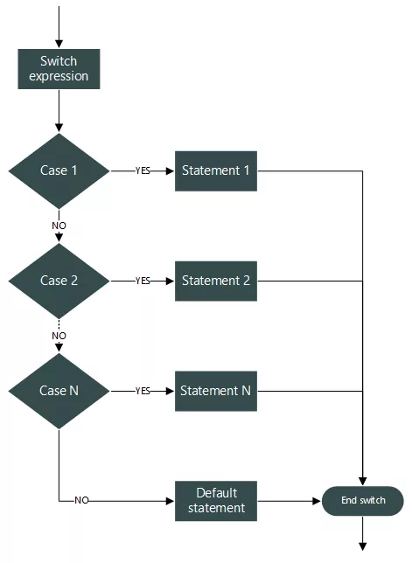
SWITCH…CASE

Slide 18
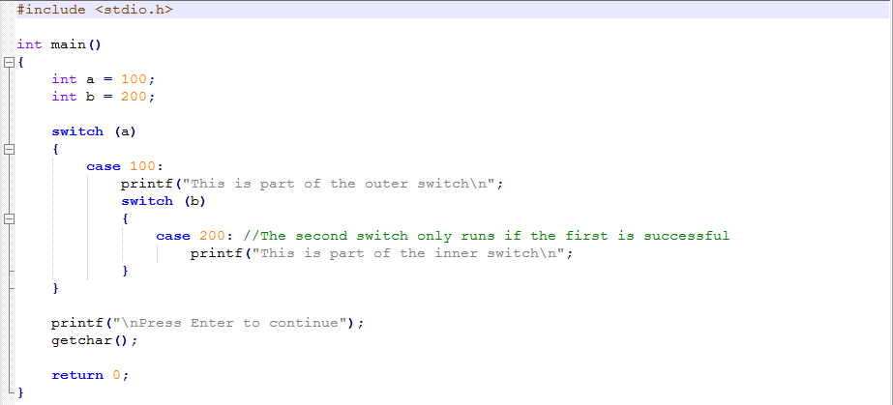
NESTED SWITCH
It is possible to nest switch statements inside of cases. Not only that, but nested switches’ case statements may contain values common to both switch statements -

